Slide 1
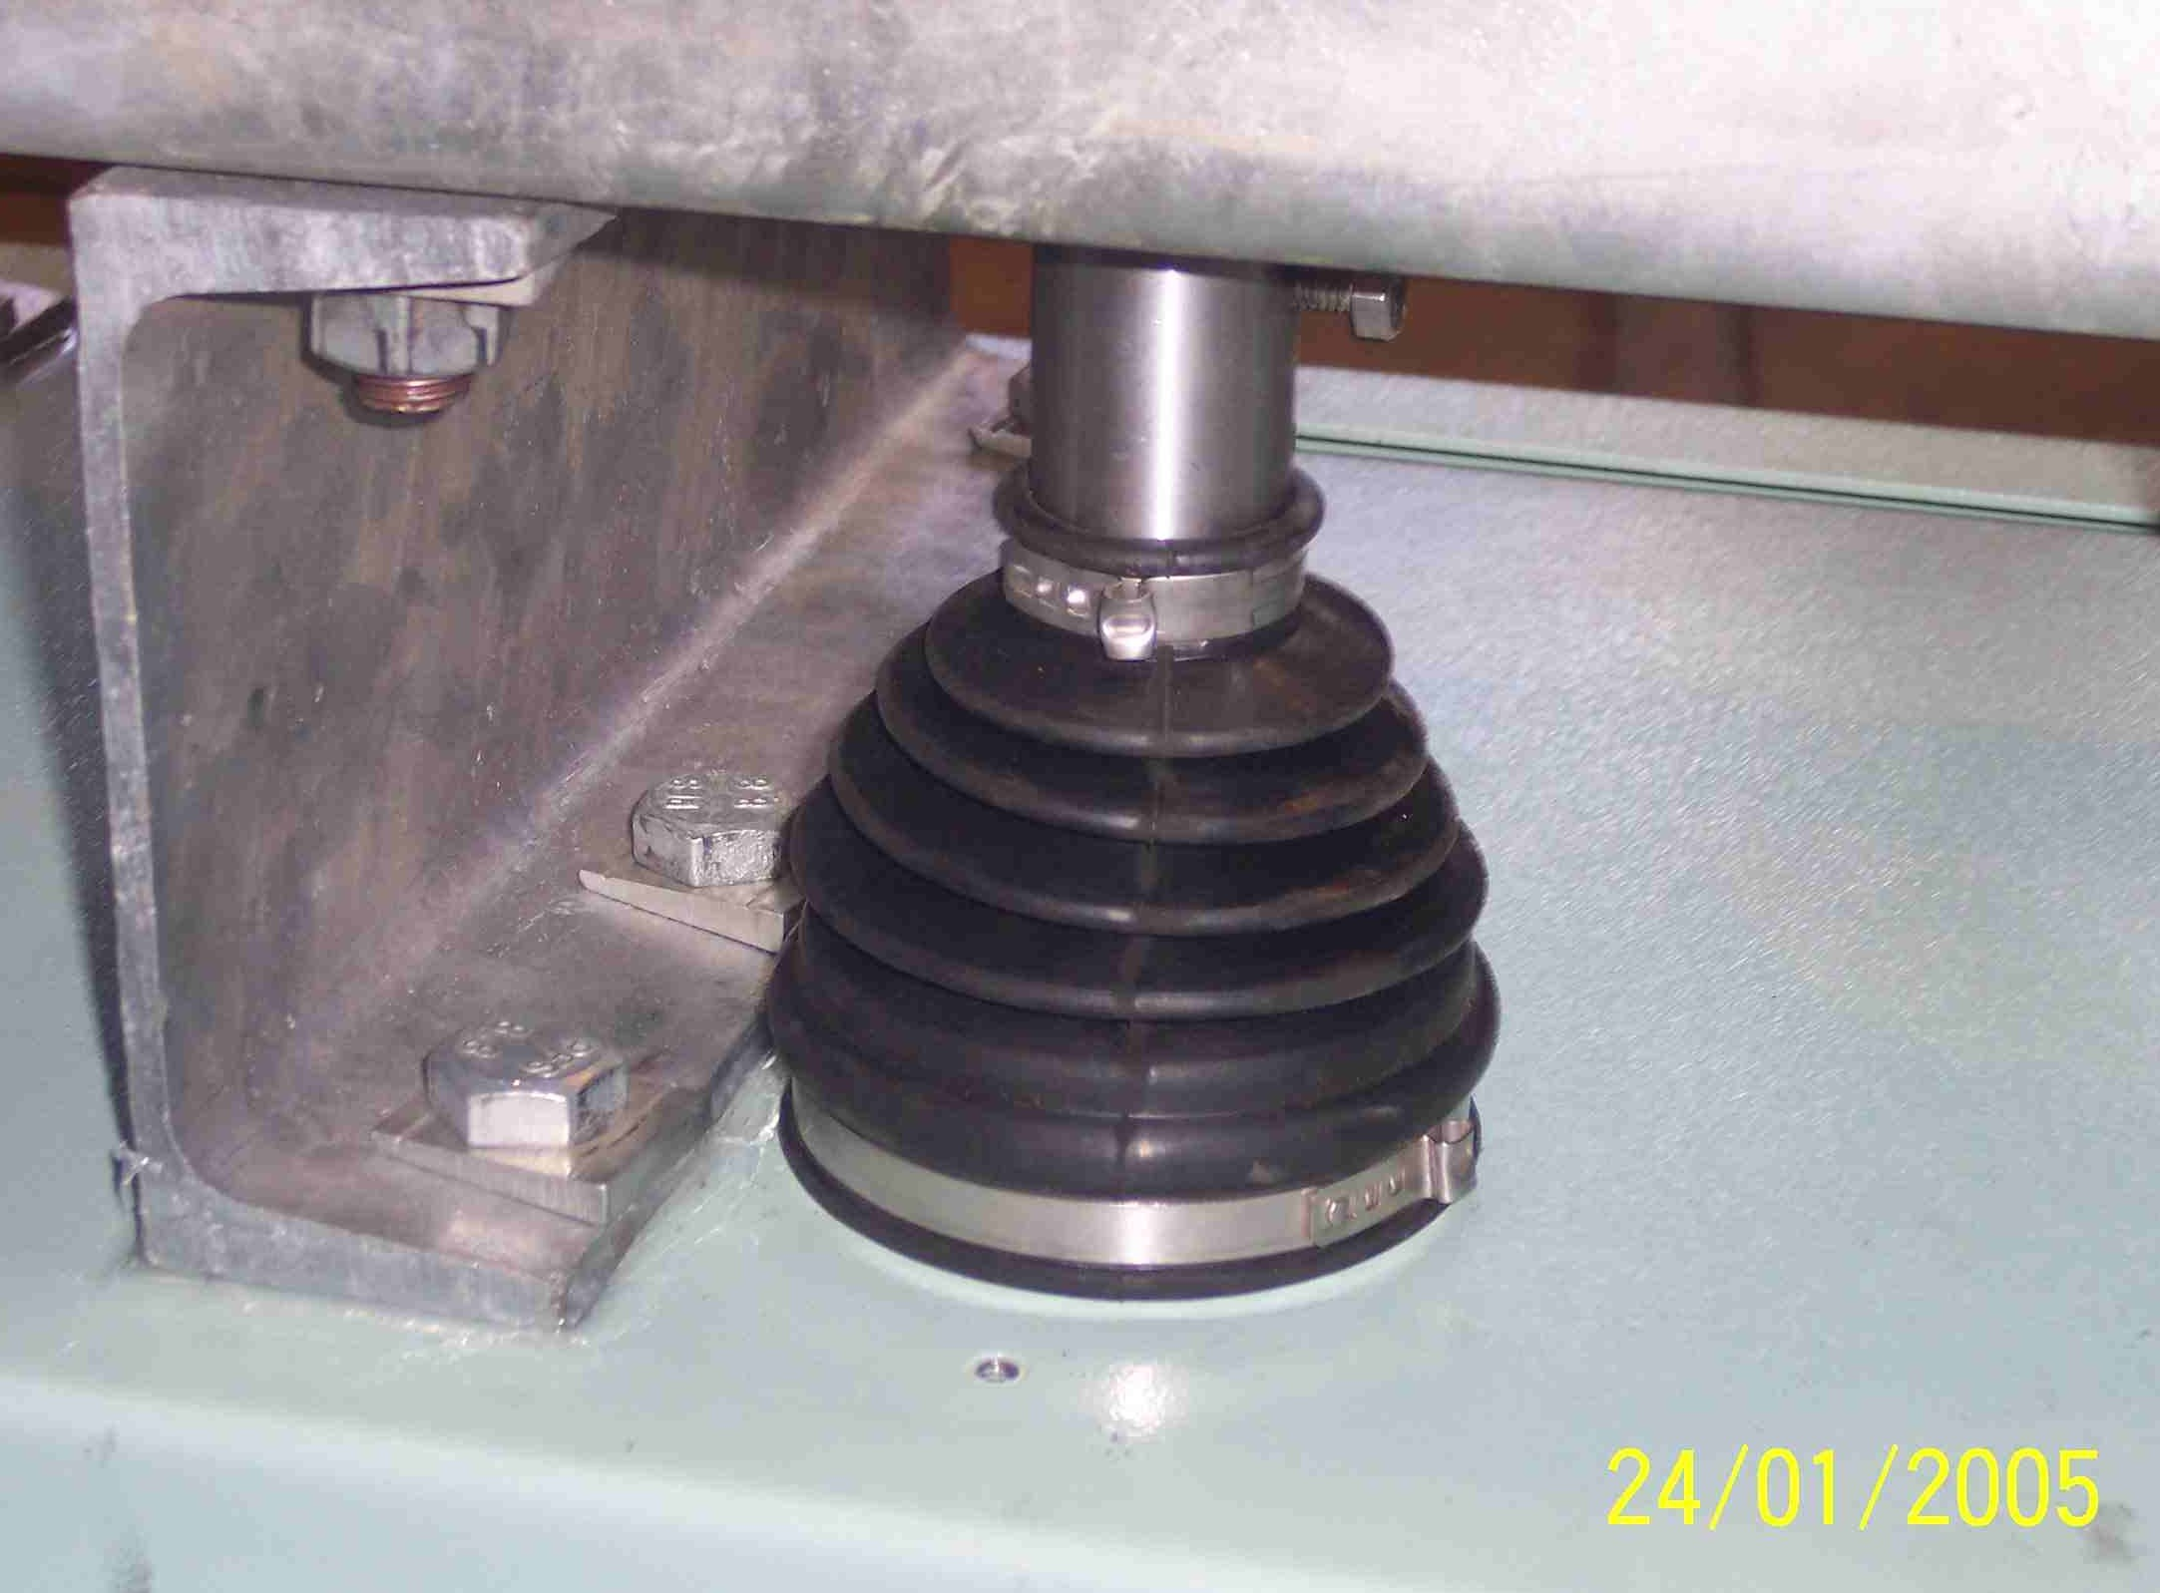
SIEMENS
HVCB SPARES
Rubber Bellow with clamps
S4951841700

